Slide 1
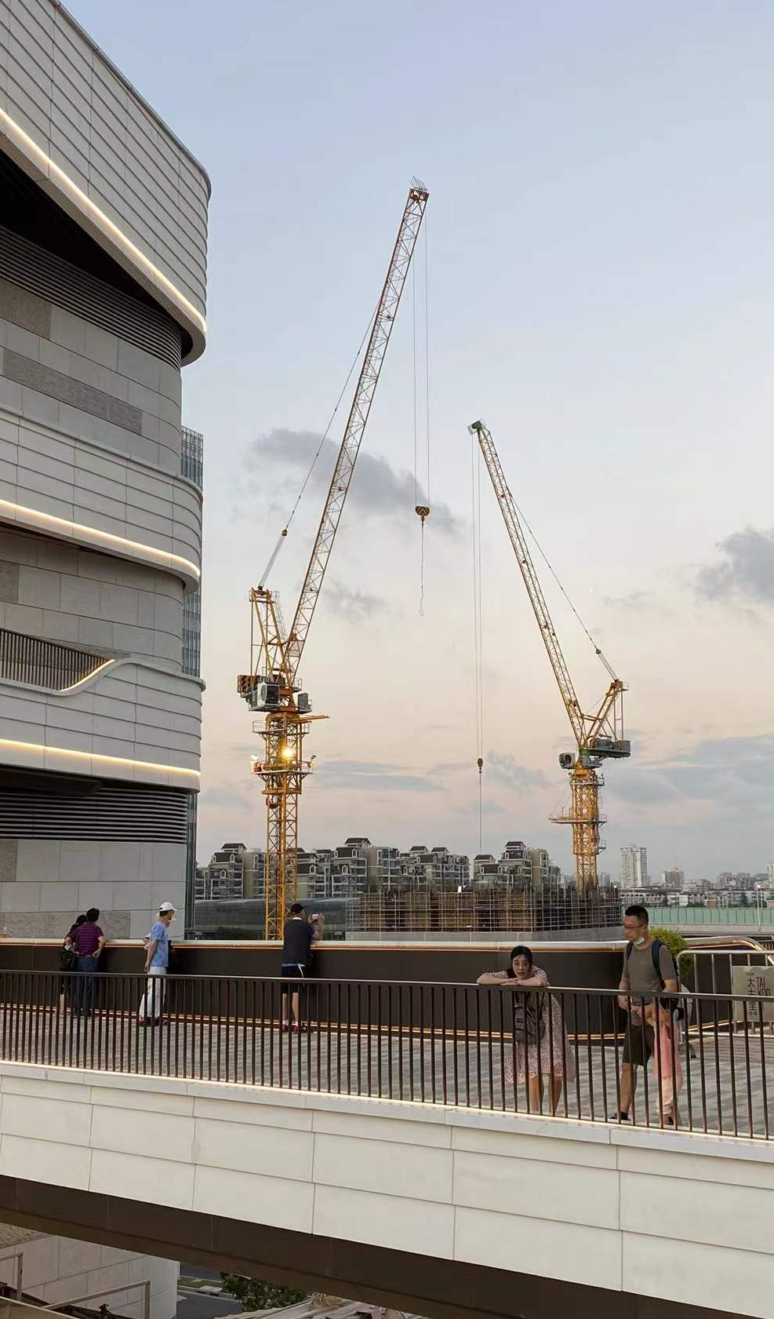
Identifying shopping centers with high operating loss risk and potential redevelopment opportunities
Mid Point Presentation
Chi Zhang
MUSA, 2022
Notes:
I made some changes to the project name. The previous one is identifying the overbuilt shopping centers. But whether a mall is overbuilt or not depends on the market demand which is dynamic and hard to prove. Therefore, I change the title to XXXX.

Slide 2
Background
Operating loss risk in an oversupplied market
Mismatch of operation value and location value
Since most of operation data is business secret, how can we quantify two questions above with accessible dataset and perhaps foresee the risk before construction?
Notes:
In Shanghai, the number of shopping centers is booming and the vacancy rate increases recent year. Since the market is oversupplied and competitive. There is high operating loss risk and follows with mismatch of operation and location value. Since most of operation data is business secret, how can we quantify two questions above with accessible dataset and perhaps foresee the risk before construction?

Slide 3





Goals and values
From the perspective of researchers, government and investors
2
Goals
3
Values
Researchers: Creative application of gravity model
Government: Land use planning and urban regeneration adjustments
Investors: Risk evaluation and seize redevelopment opportunities
Finding out shopping centers with operating loss risk with gravity model and real estate finance formulas. The result are tested with social media data.
Analyzing mismatch of operation and location value with entropy weight method and regression model

Slide 4
Data
Multivariate data resources are involved to build the model
Categories | Resources | Columns | Type
Shopping centers | Wrangled from Yingshang.com | building_area | float
 |  | rentable_area | float
 |  | built_year | integer
 | Baidu Map API | coordinate | geometry
Socioeconomics | Chinese socioeconomical year book of (2020) | population | integer
 |  | disposable_income | integer
 |  | consumption expense | integer
Urban environment | Purchased from third party | road | geometry
 |  | parks | geometry
 |  | subway_station | geometry
 |  | POIs | geometry
Social Media | Dianping.com (2022, March) | number of comments | integer
 |  | average consumption | integer
Notes:
The input data includes data of shopping centers, social economics data and urban environment data. The social media data is used to validate accuracy. All input data is historical data before 2020 Social media data used to test accuracy is up to date.

Slide 5
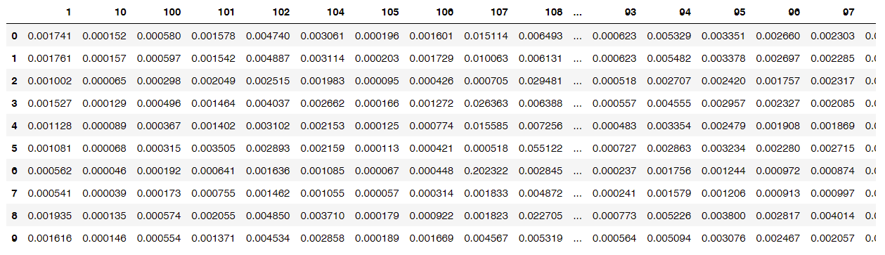
Method
Step1: Use gravity model to estimate number of customers of each shopping mall
Area and location of malls
input
Gravity Model
output
Matrix of customer share from each neighborhood and target shopping centers
Population by neighborhood
Distance matrix
Part of Gravity model results
Note: Columns represent each neighborhood, row index is the ID of each shopping center

Slide 6
Method
Step2: Calculate annual cost and income with real estate financial formulas
Number of customers
Building Area
Annual Consumption
Operation Expense per square meter
Market Penetration Rate
input
input
Income
Formula
Operating Income –Operating expenses
=NOI(Net Operation Income)
Cost
Formula
If NOI<=0, the shopping center is classified with high operating loss risk(1)
Otherwise, it’s classified as with low operating loss risk(0)
output
Number of identified malls (X)
Two lists of malls with high and low risk
Notes:
Financial formulas are utilized to calculate the income and cost of each mall.

Slide 7
Method
Step3: Test the accuracy using actual operating data from social media
Average Consumption
*
Number of comments
Operating
Index
Subset [X] number of malls with smallest index as high operating loss risk
output
List of malls with high risk
List of malls with low risk
Compare with
Model classify result
output
Accuracy

Slide 8
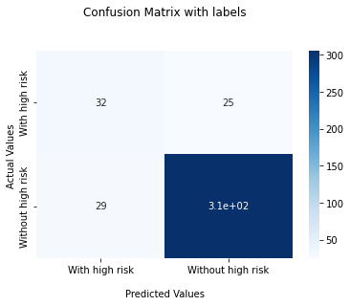
Results
The overall accuracy is good but still have improvement space
 | Accuracy
Overall | 86.22%
High operating loss risk | 56.14%
Low operating loss risk | 91.34%
57 out of 392 shopping centers
306
Notes:
The model identified 57 shopping centers with high risk out of almost 400, which accounts for 15 percent. Seeing from the confusion matrix, the overall accuracy is 86%. Since input data is before 2020 and accuracy test data is up to data. It seems that the model could predict loss risk before the construction of a new project. However, it has limited accuracy to identify shopping centers with high loss risk.

Slide 9
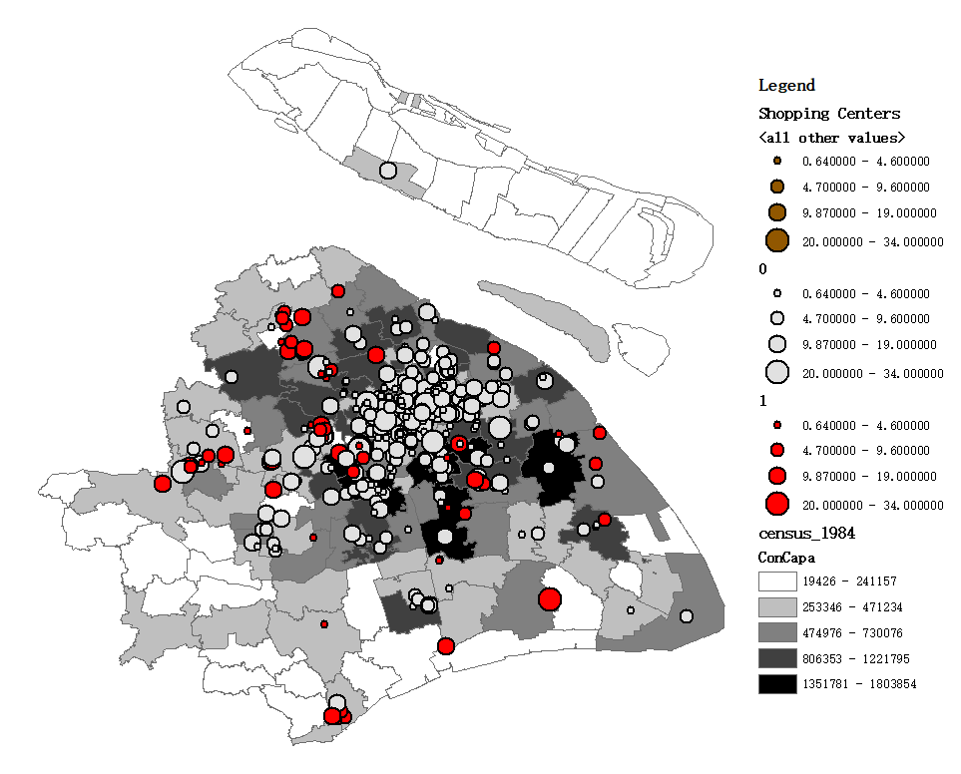
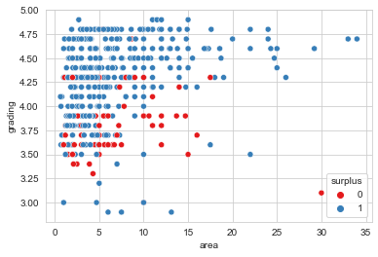
Data exploration
Surplus malls locate at suburban neighborhoods where consumption capacity is small
Malls with high loss risk are mostly located at suburban area where the total consumption capacity is small.
Others are located at urban center periphery where the market is competitive.
Shopping center area
High loss risk
Area and customer grading distribution of identified malls
Low loss risk
Consumption Capacity

Slide 10
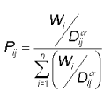
Next steps
Model improvement Identify shopping centers with redevelopment potential
Model improvement
Consider location effects in gravity model by Wi adjustment
Accuracy comparison
Entropy weight method
Quantify location value
Regression model
Identify outliers with high location value but low operating value(high risk of operating loss)
Shopping centers with redevelopment potential
Pij = the probability of consumer j shopping at mall i.
Wi = a measure of the attractiveness of each mall i.
Dij = the distance from consumer j to store or site i.
Operating Value
Notes:
For the next steps, I’ll try to consider the location effect and make some adjustments to the parameters of gravity model. I’ll compare the accuracy of two models and choose a better one. And I will also continue my next goal to analyze the mismatch of location and operation values with entropy method and regression model. Outliers with high location value but low operating value are regarded with redevelopment potential.

Slide 11
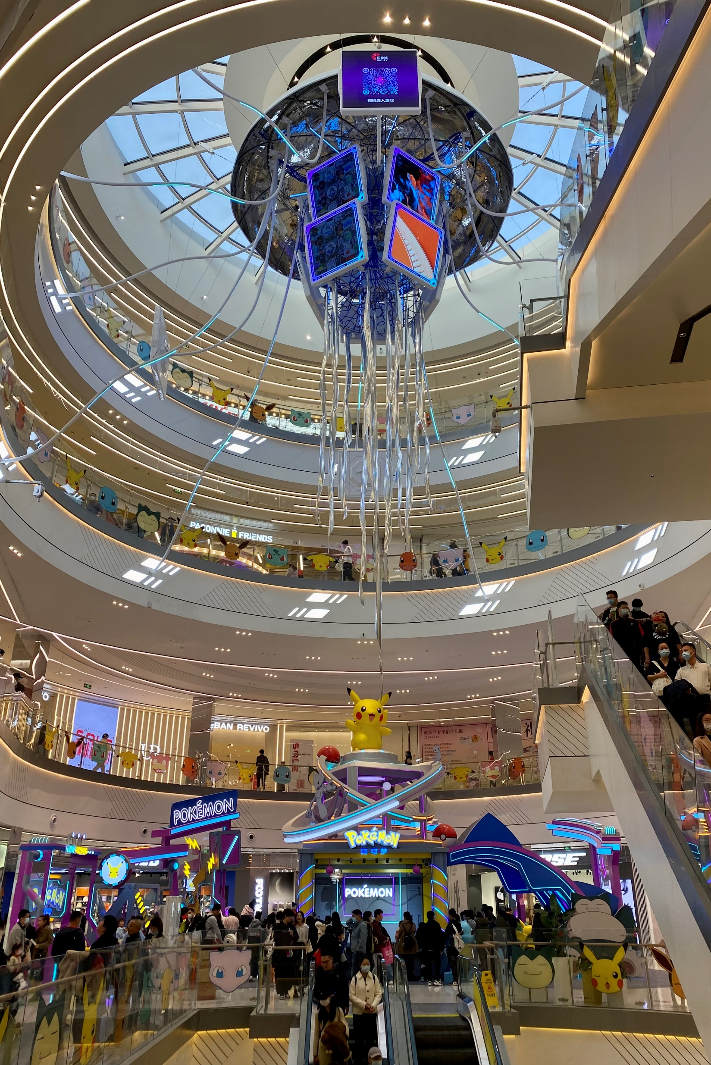
Thank you!
Q&A

